Slide 1
ANDROID CHAT APPLICATION USING BLUETOOTH
Presented By:-
Prasad Mahabare Aditya Sahasrabudhe
Under the Guidance of :- Mrs. Mrunal Fatangare

Slide 2
INTRODUCTION
The basic idea behind developing this project was to provide application i.e. app for the people who works in industry. It is tedious job to contact employees through the existing apps that is Facebook, What’s app or twitter.
It is difficult because we use it for social purpose and not for industry use.
We need to contact our colleagues for many purposes when we aren’t in condition of having a meeting & the main and most important factor of the software is that it includes android system which will provide notifications on the mobile phone or smart phone of the user.
As soon as the message is posted the user who is connected to the server chat app receives message right on the phone so it becomes user friendly and useful for use.

Slide 3
Literature SURVEY
This project is a challenge for us which have been referenced to us by internet and many kinds of books related to our field.
We have taken reference of many websites , tutorials, offline courses and many more.
The References are:-http://quickblox.com/developers/Android_XMPP_Chat_Sample
https://www.google.co.in/search?q=android+chat&espv=2&biw=1280&bih=879&source=lnms&tbm=isch&sa=X&ved=0ahUKEwj6zbyEpJ7KAhXNVI4KHRTxBpgQ_AUIBigB&dpr=1
Any ways just to make work more easily and faster it is possible with the emergence of computer technology.
This is one of the best instant messaging applications to stay connected to collogues in your company.

Slide 4
Proposed Project
Our basic aim to build the chat application is to provide minimum difficulties to the user and to maximize our product in the world of market.
It is very easy, simple and very less in size which can be transferred to any smartphone easily.
The need to make this application arise because our application is most unique and very simple than other chat application which are trending in the market.

Slide 5
algorithm
:-At Server Side:-
Start Application.
Give the Name of the user.
After That Chat Session will be Started & specific IP address will be upright down after typing the name.
Stop
:-At Client Side:-
Start the client Application.
Give the name of the user.
Type the I Address that was specified by the Server.
Then it will generate the identity of IPaddress, weather the address is right or wrong.
If right then the application will retrieve the chat page.
If the IP address is wrong then it will generate the exception.

Slide 6

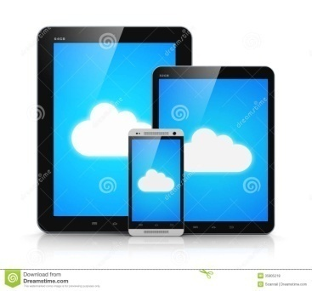
Deployment of Application
Mobile
Database
Communication between two users
User 1
User 2

Slide 7
Feasibility Study
Time Feasibility:- 4 Months

Slide 8
COST feasiblity
Cost:-10000

Slide 9
Technical Feasiblity
Software:- Java
My SQL
Android Studio
Hardware:-
Mobile Phone(Android)
Computer/Laptop

Slide 10
requirements
Hardware Requirements: -Mobile Device with minimum android version of Jellybean
Software Requirements: - 1.JAVA
2. My SQL
3. Android Studio

Slide 11
Disadvantages of Existing Application
Can go offline without the warning
Time Consuming
Huge Network Requirement

Slide 12
limitations
Video Chatting.
Voice Call.
More than Five users can’t chat at a time.

Slide 13
advantages
Smart , fast and Efficient.
Accurate
Less Time Consumption.
Latest Technology available.
Eco-Friendly.
Secured.

Slide 14
Data flow diagram

Slide 15
flowchart

Slide 17
Use case diagram

Slide 18
Sequence Diagram

Slide 19
Component Diagram

Slide 20
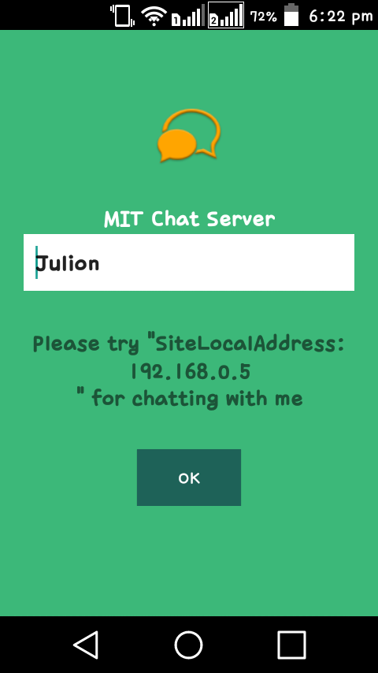
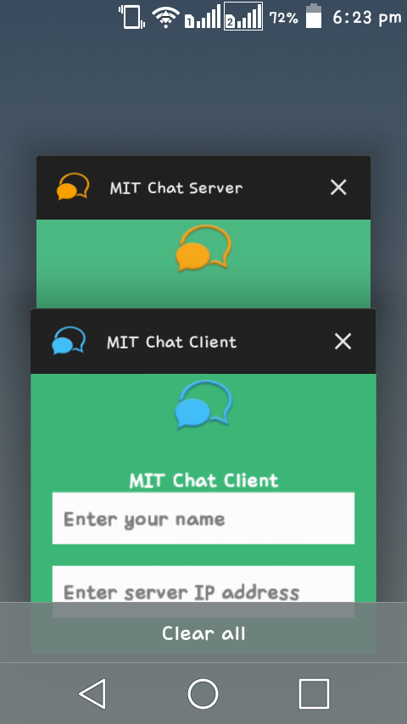
screenshots

Slide 21
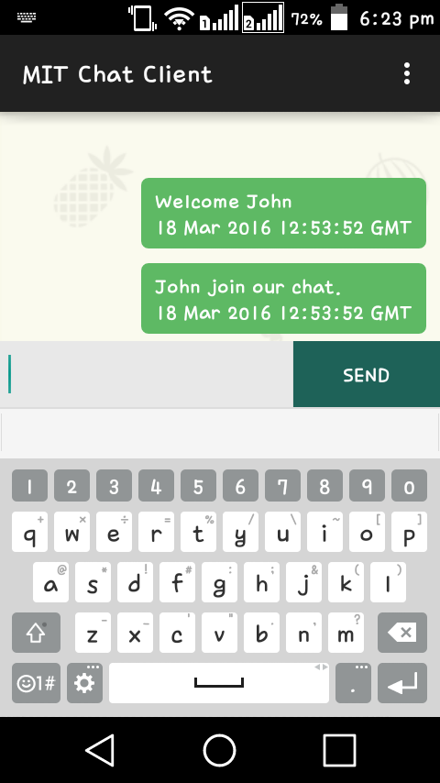
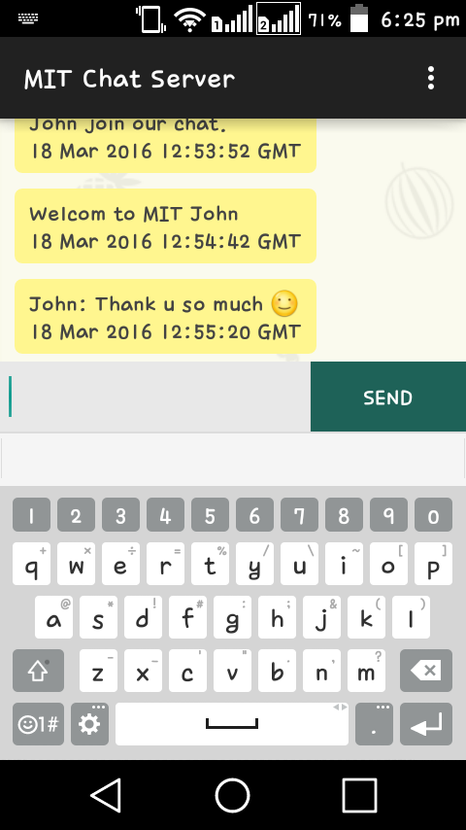

Slide 22
references
Websites:-
www.developer.com
www.computers.tutsplus.com
www.sql-tutorial.net
www.w3school.com
Books:-
1. Learn Android Studio
2.Android Studio Development

Slide 23
THANKYOU

